Slide 1

Revolutionizing how we work
By team Job Works

Slide 2
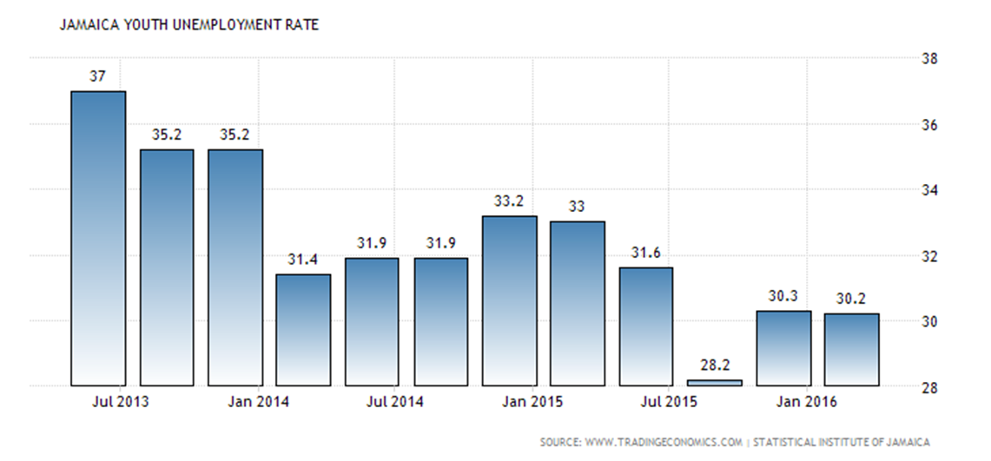
Problem

Slide 3
Solution
Our solution is to devise an app that will do the following
Have employers search for suitable employees
Have employers search for suitable jobs
Lowering the employment rate in Jamaica
creating more jobs opportunity in Jamaica

Slide 4

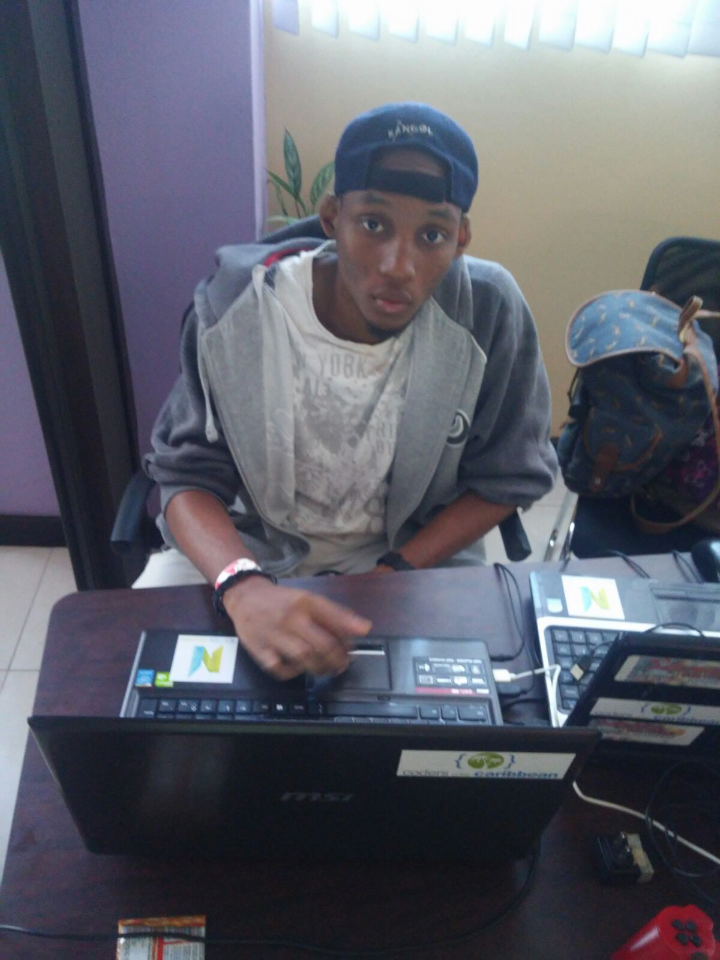

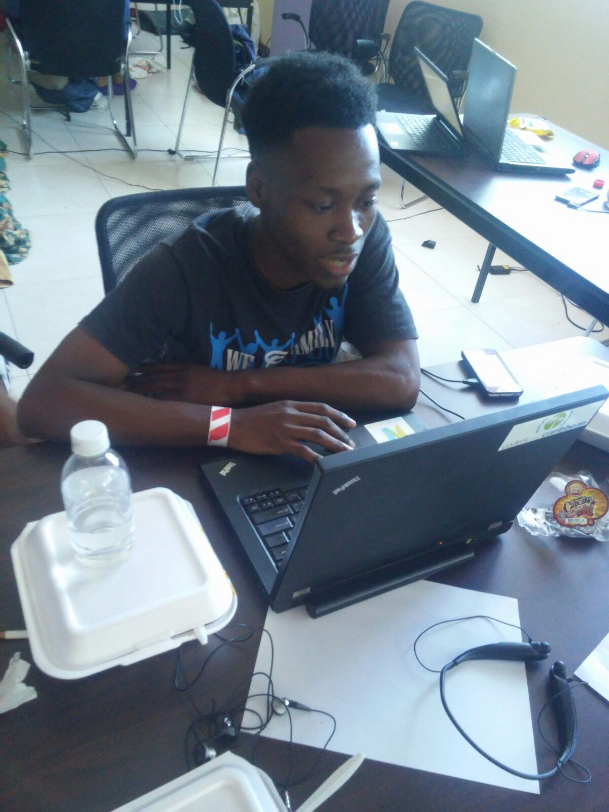
Team
Joseph Thomas Raheem Campbell
Mem
Deon Coke Randy Bernard

Slide 5
Marketing/Sales
Target Customers
Our target customers in Jamaica who are between the ages of 18-35
Employers of start-ups and small businesses
To reach our business partners in Jamaica through both social media and the printed media

Slide 6
Elevation Statement
For Target Customer
our most important aim is to reach our unemployed induvials in Jamaica and who are seeking to get and qualify job in Jamaica.
Who statement of need of opportunity.
Provide jobs for educated uneducated induvial.
our aim is to get unemployment rate down to by 5%.
The product /is a product category
Jobworks is based on developing
the unemployed induvial uneducated
educated and induvial we aim to empower our youths to change the world

Slide 7
Elevation Statement
that completive advantage
Concluded
what makes us different is the development of the app is designed with Jamaicans in mind and the ease of the that our applications have

